Slide 1

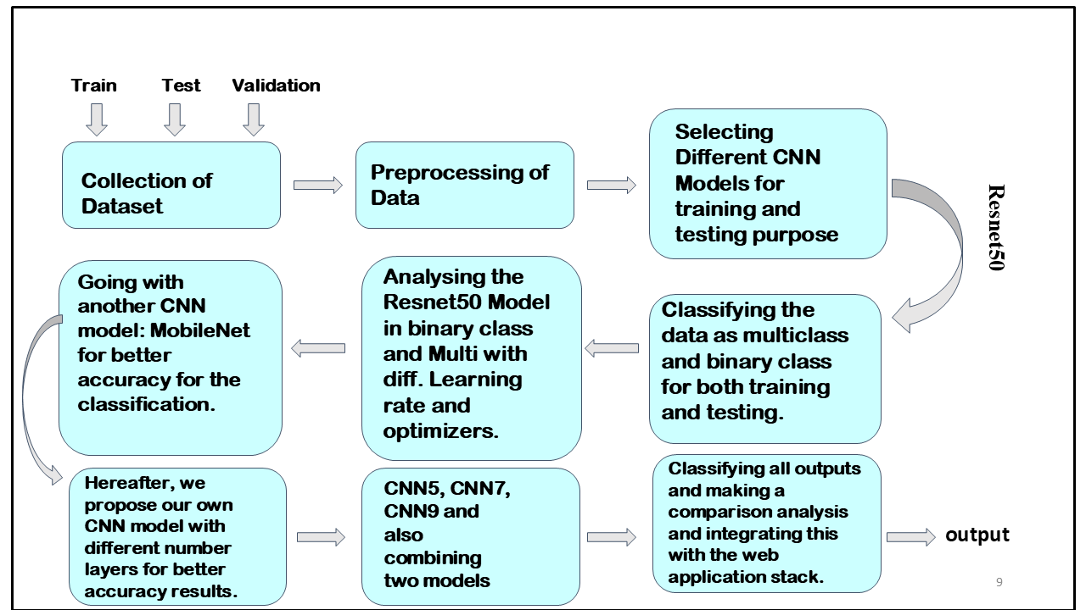
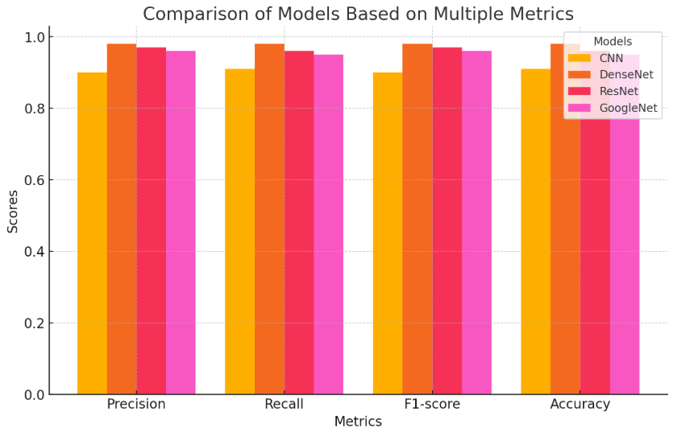
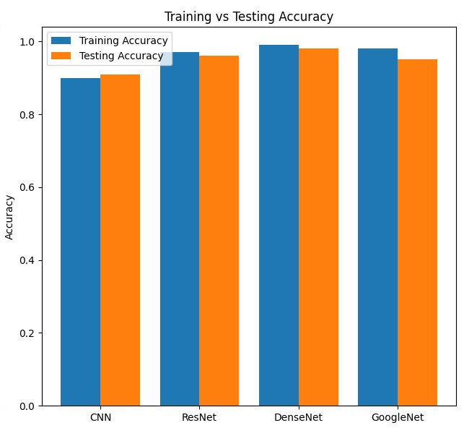
Detection and Classification of Retinal Disease Using Convolution Neural Network and Transfer Learning
Aditya Agarwal (RA2111004010177), Abhinav Panwar (RA2111004010210), Rohan Gupta (RA2111043010033),
Dr. S. Latha (Associate Professor, Department of Electronic and Communication Engineering)
Department of Electronics and Communication Engineering, SRM Institute of Science and Technology, Kattankulathur
INTRODUCTION
METHODOLOGY/BLOCK DIAGRAM
RESULTS & INFERENCE
CONCLUSION
This project focuses on classifying Optical Coherence Tomography (OCT) images for retinal disease detection using a custom CNN and fine-tuned transfer learning models like MobileNet,ResNet50, GoogleNet, and DenseNet, optimizing accuracy.
The OCT image classification project effectively distinguished AMD-affected eyes from healthy ones using deep learning models.
DenseNet achieved the highest accuracy of 98%, outperforming ResNet50 and GoogleNet. Among custom CNN architectures, CNN9 performed best with an accuracy of 94.75% on a balanced dataset.
This study demonstrates the effectiveness of machine learning and deep learning models, particularly DenseNet, in accurately classifying OCT images into categories such as Normal, Drusen, CNV, and DME. DenseNet outperformed CNN and ResNet by 3–5% in key metrics, achieving an impressive 98% accuracy.
This highlights both the diagnostic power of advanced AI models and the significance of intuitive design in medical applications.
MOTIVATION
REFERENCES
The motivation behind this, stems from the escalating prevalence of eye disorders.
There’s an imperative need for robust and efficient tools that can aid in early detection and intervention.
DESIGN
[1] K. Patil, A. Mahajan, S. Balamurugan, P. Arulmozhivarman and R. Makkar, "Development of Signal Processing Algorithm for Optical Coherence Tomography", Proc. 2020 IEEE Int. Conf. Commun. Signal Process. ICCSP 2020, pp. 1283-1287, 2020.
[2] M. D. Abràmoff, M. K. Garvin and M. Sonka, "Retinal imaging and image analysis", IEEE Rev. Biomed. Eng., vol. 3, pp. 169-208, 2022
Developed multiple deep learning models: DenseNet achived highest accuracy.
Integrated model into web-interface for real time classification
Used transfer learning and data augmentation for efficiency with limited data.
PROBLEM STATEMENT/OBJECTIVE
REALISTIC CONSTRAINTS
Handling large OCT datasets without a dedicated GPU leads to slow processing and memory issues.
Limited access to free GPU resources restricts long training and model experimentation.
To enhance the performance of retinal image classification by integrating a fine-tuned pre-trained CNN model for effective transfer learning, ensuring rapid and reliable categorization of normal and abnormal retinal images.
CONFERENCE PUBLICATION
International Conference on Advanced Research in Electronics and Communication Systems, ICARECS 2025, Chennai, India, 26th-27th February 2025.
ENGINEERING STANDARDS
ISO 10993-1:2018: Biological evaluation of medical devices: evaluation and testing within a risk management process

